Slide 1
1
PROBLEMS INVOLVING SELECTION

Slide 2
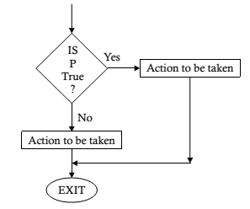
INTRODUCTION
This process of decision-making is implemented through a logic structure called selection.
A predicate, also called a condition, is tested to see if it is true or false.
If it is true, a course of action is specified for it; if it is found to be false, an alternative course of action is expressed.

Slide 3
FLOWCHARTING AND ALGORITHMS
Note that a course of action may involve one or more sequences of operations, and there should be a common meeting point to satisfy the single rule pointed to by the connector containing the word “Exit.”
A flowchart may contain any number of decision boxes depending on the processing requirements, and the boxes may appear in any sequence depending on the program logic decided.
For example, a number of decision boxes may follow one another.
The following flowcharts provide an explanation of the logic to clarify this concept

Slide 4
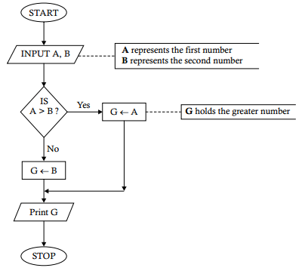
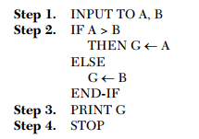
EXERCISE
Problem 2.1. Construct a procedure to show how to determine the greater of two given numbers.
Task Analysis. We must determine the larger of two numbers. The task is to compare the given numbers to find the greater of them.

Slide 5
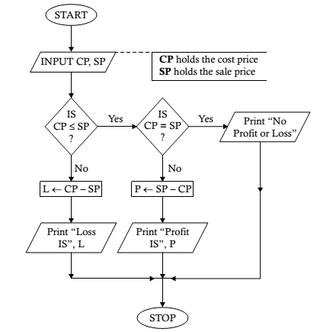

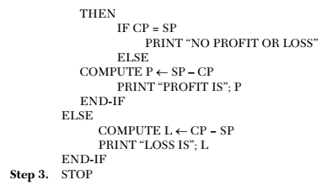
EXERCISE
Problem 2.2. Develop a flowchart to show how the profit or loss for a sale can be obtained.
Task Analysis. The profit or loss for a sale can be obtained if the cost price and sale price are known. However, there is a need to make a decision here. If the cost price is more than the sale price, then it indicates a loss in the process; otherwise, there will be either zero profit (no profit or a loss) or some profit.

Slide 6
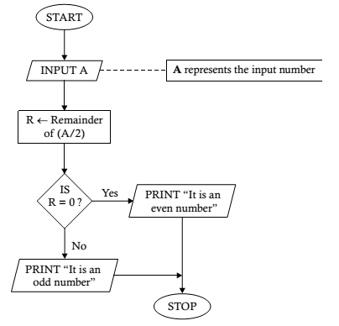
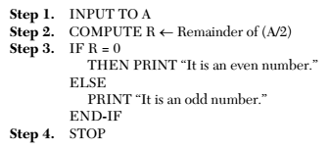
EXERCISE
Problem 2.3. Construct a flowchart to determine whether a given number is even or odd.
Task Analysis. We know that a number is an even number if it is completely divisible by 2. This means that if we perform integer division upon the given number, then the remainder of the division will be zero. To construct the flowchart, we accept a number as input, obtain the remainder of the integer division by taking it as the divisor, and then check whether the remainder is zero. If it is zero, then our conclusion will be that the number is an even number; otherwise, it will be an odd number.

Slide 7
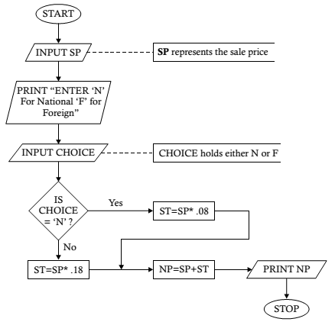
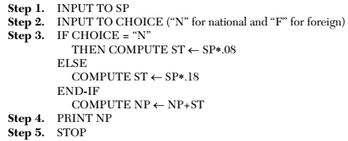
EXERCISE
Problem 2.4. Determine the net payable amount on a sale. The net payable amount consists of the sale price plus sales tax. The sales tax is decided as 8% of the sale price for national items, 18% of the sale price for foreign items.
Task Analysis. We need to calculate the sales tax first by taking one of the two given rates. For this purpose, we require two inputs: the sale price of the item under consideration and the origin of the item. Let us assume that we provide “N” or “F” as the input to indicate “national” or “foreign,” respectively.

Slide 8
EXERCISE
Problem 2.5. The grades in a certain class are determined by coursework and a written examination. Both components of the assessment carry a maximum of 50 points. The following rules are applied by the examiners to determine whether a student passes:
A student must score a total of 45% or more in order to pass
A total grade of 44% is moderated to 45%
Each component must be passed with a minimum of 20 points
If a student scores 45% or more, but does not achieve the minimum grade in one component, he is given a technical fail of 44%, which is not moderated to 45%.
Develop a flowchart showing how to input the grades for each component and output the final grade and the result.
Task Analysis. The readily available facts about a student are the grades obtained for the coursework and written examination. These can be supplied as the input to obtain the desired output. The procedure includes finding the total score and then checking to determine whether it is “pass,” “fail,” or “technical fail.” A moderation, i.e., an increment, of the final score is also done, if required, when a student obtains a total score of 44%. Our objective is to show the solution interactively for one student at a time. No input is needed to identify the student.

Slide 9
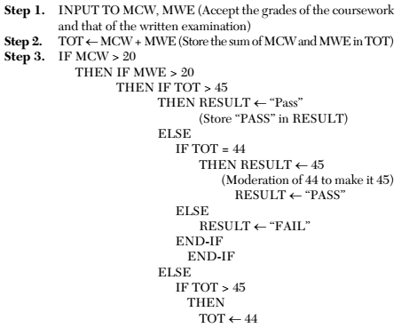
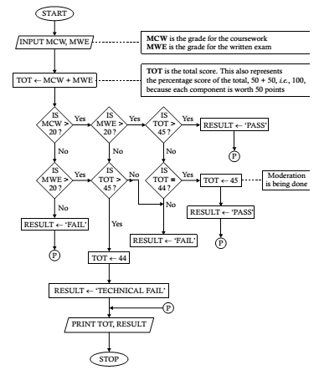
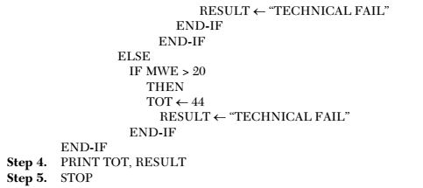
EXERCISE

